Slide 1
Focus on
Volunteering
College Prep
Mr. Gordon
jgordon@bisdtx.org

Slide 2
Upcoming Events
Oct. 24-29 CRCA Spirit Week
Please check the board in the cafeteria for themes of the day
Fri. Oct. 29th Drama Club Halloween Party
Fri. Oct. 29th 4:10-9:00 PM CRCA Lock-In $5 Please pay Mr. Gordon Price includes 2 slices of pizza and chips, open gym, games, etc.
hi

Slide 3
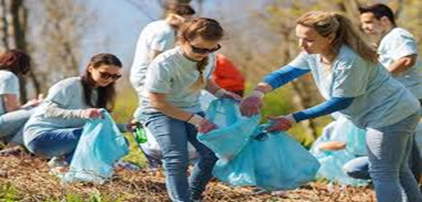
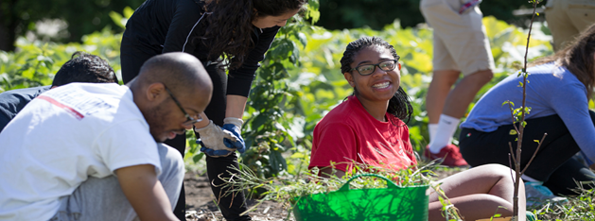
How Many Volunteers Hours Do I Need?
There is no magic number for the amount of community service hours you need.
Most colleges do not require a certain amount of hours, but it may help you get accepted and it certainly expands your college resume/ application.
hi

Slide 4
How Many Volunteers Hours Do I Need?
Many scholarships, however, do require community service hours.
A good goal is 25 hours a year throughout all four years of
high school.
hi

Slide 5
Why Should I Volunteer?
The number, however, is less important than the why.
Ask yourself:
What am I doing?
Why am I doing it?
What am I getting out of it?
If you can effectively answer these questions it will be more important than the number of hours.
hi

Slide 6

Why Should I Volunteer?
Volunteering can also help you in determining if your future career is right for YOU.
Colleges want to accept people who will change the world.
When applying they want to you see you have
Passion and Commitment.
hi

Slide 7
Where Should I Volunteer?
Many organizations are looking for volunteers, including the Bastrop Library, Bastrop County Animal Shelter, your local church, Bastrop Food Pantry, and the PAC.
You need to log these hours, so you can remember them for college applications.
You can log them in a Google Doc or
get a log sheet from Mr. Gordon.
hi

Slide 8
Volunteer Opportunity
The National Honor Society and other volunteers will be meeting on Saturday, October 23rd from 8 to 11 AM in the CRCA library for an orientation meeting for their Adopt a Street program. Expect to tour the one-mile radius around the school and discuss the protocol for future trash pick ups.
If you are interested, please email Violet Arce-Vergara at 972831@student.bisdtx.org. Only 30 spots are available.
Other volunteer opportunities will be posted in the Google Classroom as they become available.
hi

Slide 9
Today’s College Prep Assignment
In the comments section of today’s College Prep,
answer the following question:
Where do you volunteer?
hi

